Slide 1
A Day in the Life of a Data Driven Organization
Accelerating your journey to becoming a Data-Driven Enterprise

Slide 2
Agenda
Data Driven Enterprise Vision
A Day in the Life of a Data Driven Organization

Slide 3
Data Driven Enterprise Vision

Slide 4
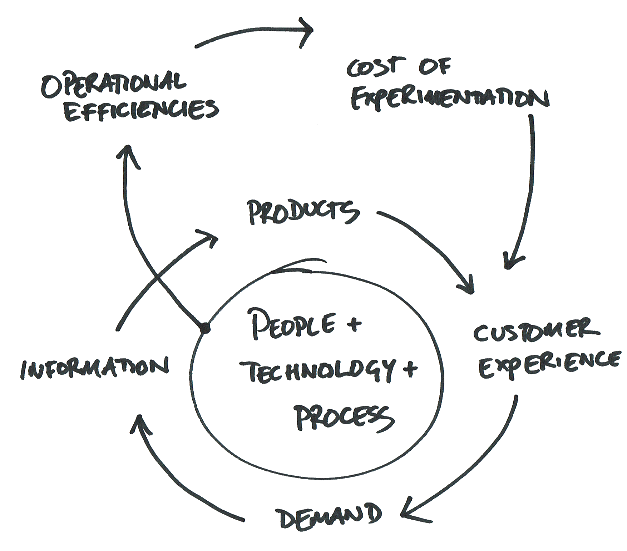
The Data-Driven Organization
“An organization that harnesses data as an asset, to drive sustained innovation and create actionable insights to supercharge the experience for their customers, partners and employees so they demand more.”

Slide 5
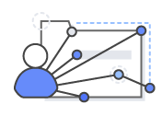





Introducing AWS D2E: Partnering for Innovation
The transformation is challenging, requiring a strong vision, new culture, skills and technology
Understanding what “great looks like”
Identifying and prioritizing use-cases
Creating sponsorship & business case
Culture of self-service
Gaps in skills and technologies
Data privacy, security, compliance and governance
Notes:
[steve]
PRIMARY MESSAGE: D2E is designed to partner with our customers, to help them get the flywheel going and accelerate it, by addressing technical debt and quick wins. Analytics Transformations can be challenging. It can be difficult to understand what “great looks like”, what the end-state and benefits of a transformation are. It is difficult to know where to start and how to counter naysayers and sceptics within an organization. The business case is not predicated solely on cost-takeout, it can be challenging to justify large-scale investment. Sponsorship is highly cross-functional and therefore, natural sponsors aren’t always apparent. The skills and technologies required are constantly changing. Data privacy and security are crucial in order to ensure compliance, transparency and trust.
Hook: And this is why we’ve built a new program called “Data-Driven Everything”…

Slide 6
Design Workshop – The Modern Data Community
Data-driven organizations enable agility by pushing responsibility to the edges, to the producers and consumers of data
Producers
Data-Lake Platform
Consumers
“Teams that want to share data”
“Team that runs the marketplace”
“Teams that want to use data”
Domain expertise
Data ownership and governance
Data quality
Metadata Management
Build security controls
Build and run the platform
Simplify on-boarding
Enterprise datasets
Training and community
Execute business priorities
Business analytics development
Data Discovery
Data pipeline development
Creation of new insights
Level of decentralization depends on maturity of skills, complexity of business, domain knowledge required, and pace of tech change…
Notes:
In the past, governance, data quality, infrastructure and security were managed by one central organization that generally lived in IT. While this ensured consistent adherence to policies, it created a bottleneck for innovation and availability of information. Forbes recently published an article that said, “By making 10% more data accessible, a typical Fortune 1000 company will see a $65 million increase in net income.” Given the enormous economic benefits that data can bring to a company, this challenge that we see around people and process is one that must be solved.
To support agility within an organization’s data platform, to support the rapid execution of use cases, we need to create a decentralized model for managing these assets.
Based on our own experience with the Amazon Marketplace, where we have thousands of developers and thousands of data sources using over 100PB of data to support over a million analytics jobs per day, the AWS team is working with customers on the best practices around creating a modern data marketplace architected to run in a decentralized environment where data can be discovered transparently and used with established rules, security and commitments from the owners of the data. This allows a company to operate in a both an agile and a secure way. This “data marketplace” consists of the following 3 roles: 1) Data Marketplace Team, 2) Data Producer, 3) Data Consumer.
The Data Marketplace Team (DMT) is responsible for managing the tools and technology used to support the marketplace as well as establishing the “governance” policies, on-boarding of users into the marketplace and training associated with using the marketplace and tools used as part of the marketplace. They are also responsible for establishing the “data contract”. This contract is what the data producer is committing to maintain when they publish data into the marketplace. It may include things like data quality certification levels, update frequencies, end of life policies, ownership, business metadata, notification rules, etc. This contract is immutable, which means that once a producer commits to a contract, changes can only be made by establishing a new contract. At the onset of the project, the DMT will establish the rules for data quality certification. As an example, data may be characterized with different levels, ie, Gold, Silver, Bronze, Public. Gold data might be data that is the most critical to the business, includes sensitive information such as PII data, and is managed by the DMT team. There may be stricter access control rules that are followed for this data. At the other end of the spectrum, Public data may not have any rules around it and there is no formal approval required to access that data.
The Data Producer generally knows the domain best and understands the scope and intent of the data. In this model, they own the data and the governance around the data. They are also responsible for maintaining the ongoing quality and availability of the data according to their published contract. The producer is also responsible for granting access to consumers.
The Data Consumer is the user of the data. They understand and execute the business priorities and creation of new insights, data discovery and business analytics development. They may create their own data pipeline to expand the usage of the data. In this case, data consumers create a similar contract to that of the original data they used. One key challenge for a data consumer is simply finding the right data for their specific purpose and understanding the intent and quality of what they are using. These users can spend hours trying to find the data they need for their analysis or worse yet, recreate data that already exists somewhere in the company. Creating transparency to data assets is one of the key benefits to the data consumer in this model.
The marketplace creates a decentralized environment where users can search and discover datasets, request access to data, publish data, create new data pipelines, understand the data quality and lineage of diverse data sets. This creates an agile environment that allows company to move at the speed of business, with the right tools for the right job, while still adhering to data security rules and regulatory considerations and reducing the risk of having their precious data assets lost in a swamp of information.
During Day 2 of the Design workshop, we introduce this concept and have a high level discussion of your specific governance needs. The Marketplace can sometimes drive its very own D2E workshop!
HOOK: So, once we complete the workshop and have a plan ready to execute on the MVP, we move into the Pilot Phase.

Slide 7
Data-Driven Organization’s Challenges
Where is the data?
CRM, accounting data, inventory…
Can I connect BI to my datalake?
Slicing and dicing data coming from different databases, APIs and fileshares is not really easy.
Where to store the data?
The Data loaded into new servers that power a Data Warehouse.
How to make data ready-for-analytics?
The Data needs to undergo ETL in staging area.
Only data producers know how. Some data value ”lost in translation”.
Who sees what?
Manual process of granting permissions. People don’t like to wait!
After some time it becomes unmanageable to know who is accessing what…
Going beyond dashboards
AI/ML

Slide 8
Common DataHub …
… is a distributed data lake that makes data easily discoverable, shareable, and accessible across the whole organization.
Notes:
This has been developed by ProServ for another customer and used in production. And it has been modified for the purposes of this demio.

Slide 9
Common DataHub highlights
Share data across the organization
Store anything and organize your data
Discover datasets
Process your data
Organize your teams and environments
Consume data and use cutting edge services for your next big-idea

Slide 10
A Day in the Life of a Data Driven Organization

Slide 11
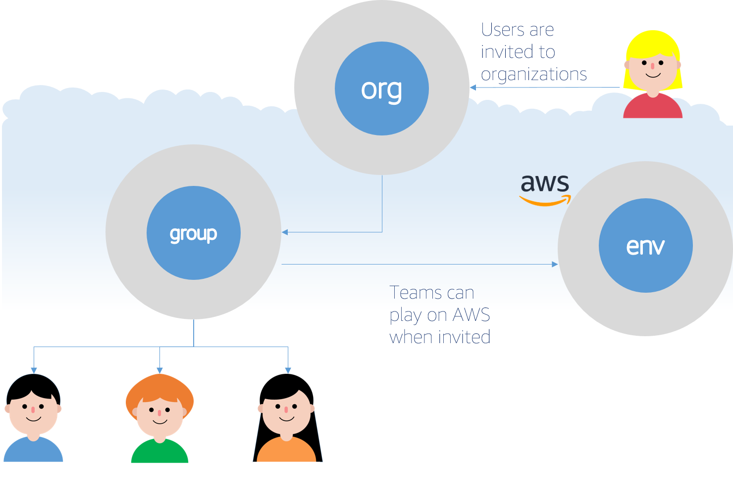
Mapping Organisations

Slide 12

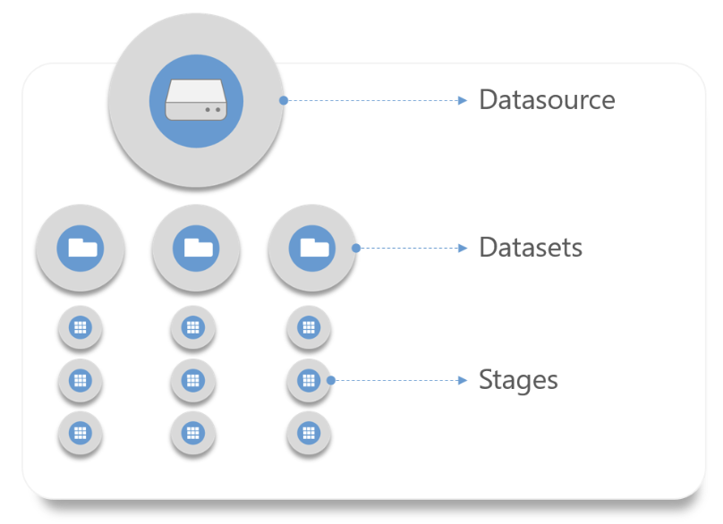
Data Hierarchy
Its all starts with data…
99.99% availability
99.999999999% durability
Encryption & versioning
Virtually infinite storage
Notes:
A CommonDataHub Datasource is a container of actual data files. It can be compared to a database, or to a fileshare.
There is no restriction on the type of data that can be stored in a datasource, and there is no limit in the amount of data that can be stored in the datasource. Users can select the region where the data will be stored, among the Cloud geographies that Common datahub supports.
Users can organize datasource as they wish, however a good pratice is to map a datasource to a data provider, like a system, an application or a database.

Slide 13
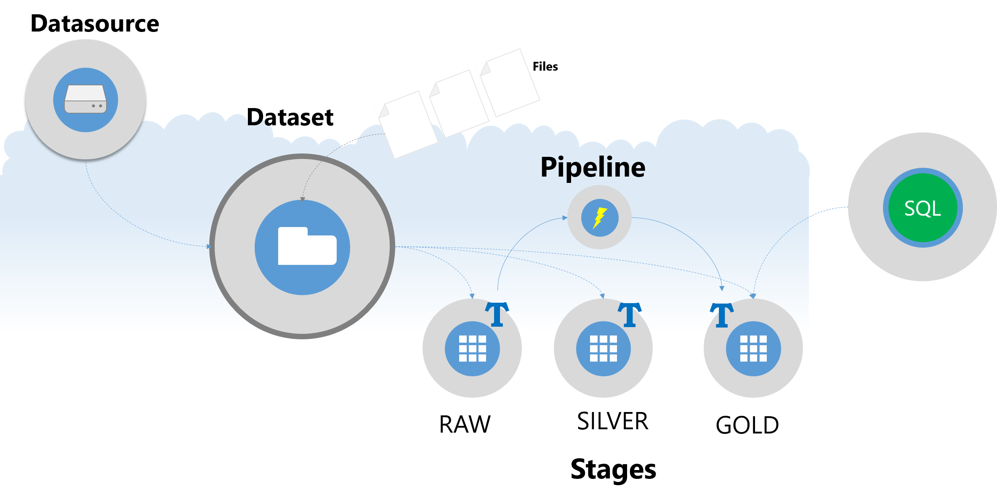
What is a Dataset and Stage?
A Stage is one representation of the dataset, which can be queried using SQL.
Notes:
A Stage is a table, which underlying data are stored within a parent Dataset folder.

Slide 14
Story #1
I am a Producer, I want to
Ingest data to the lake with minimal blockers and maximum speed.
Describe a minimum level of detail about my data as part of ingestion.
Approve a consumer to access my data.

Slide 15
Story #2
I am a Consumer, I want to
Search, review, and access to data.
Analyze my data with a basic query (Data Analyst).
Analyze my data with a descriptive dashboard (Business Analyst).
Train and deploy machine learning models (Data Scientist).

Slide 16
Story #3
I am Information Security, I want to
Understand who has access to data.
Understand what people are doing with our data.

Slide 17
Story #4
I am a Data Officer, I want to
See the data on the platform, understand key aspects of information about it.
Review the data quality on the platform.

Slide 18
Need for Increased Automation of Data Quality Validation
RDBMS enforce strict schema and integrity constraints
Data increasingly lives outside of an RDBMS:
e.g., in file systems, data lakes, key-value stores, spreadsheets
often no schema enforced data often moved between different systems large datasets often combine data from many heterogeneous sources
Data quality validation is important, but often requires tedious and repetitive work automation of data quality validation is necessary

Slide 19
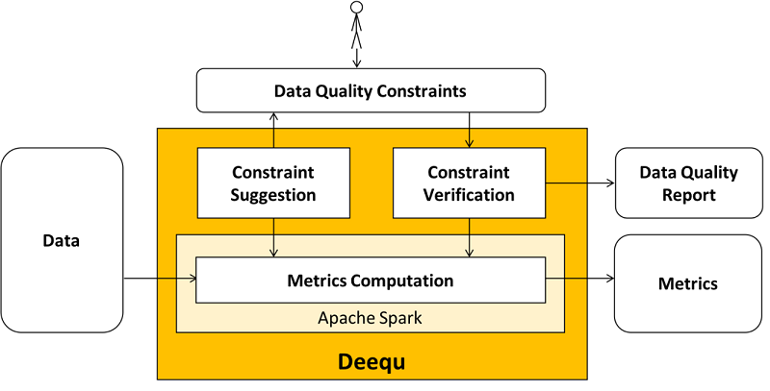
Test data quality at scale with Deequ

Slide 20
Anomaly Detection and Constraint Suggestion
Difficult to set thresholds for certain constraints
Deequ supports anomaly detection on time series built from history of metrics
Many diverse datasets, sometimes with hundreds of attributes
→ automatic suggestion of constraints required

Slide 21
Constraints Examples per Column
﻿isComplete
﻿isUnique
﻿isNonNegative
﻿isInRange(0, 100)
﻿hasConsistentType(integer)
﻿hasCompleteness >= 0.90
isContainedIn(Array(”Value-A", ”Value-B"))
isContainedIn(Array(”Value-A"), >= 0.95)

Slide 22
Summary
Where is the data?
CRM, accounting data, inventory…
Can I connect BI to my datalake?
Slicing and dicing data coming from different databases, APIs and fileshares is not really easy.
Data is consumable by any BI tools. No loading, no data movement, no infrastructure to buy.
Where to store the data?
The Data loaded into new servers that power a Data Warehouse.
The data stored in a durable and highly available storage powered by AWS.
Complex organizational structure mapped to different AWS environments.
How to make data ready-for-analytics?
The Data needs to undergo ETL in staging area.
Complex data transformation workflows can be implemented using simple SQL statements.
Who sees what ?
Manual process of granting permissions. People don’t like to wait!
After some time it becomes unmanageable to know who is accessing what…
Authorized users can publish, discover, request access, and eventually use data.
Data security best practices are applied automatically by Common DataHub.
Find the data you need with Common DataHub Virtual Data Catalog.
Data is searchable by tags, description, and metadata.

Slide 23
APPENDIX

Slide 24
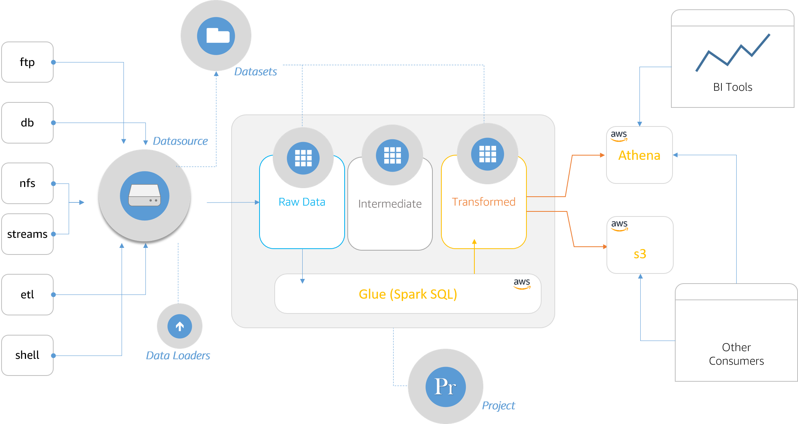

Slide 25
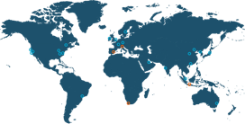

AWS Global Infrastructure – Regions and Availability Zones
AWS Regions are comprised of multiple AZs for high availability, high scalability, and high fault tolerance. Applications and data are replicated in real time and consistent in the different AZs.
AWS Availability Zone (AZ)
AWS Region
Transit
AZ
Datacenter
Datacenter
AZ
AZ
Transit
AZ
Datacenter
A Region is a physical location in the world where we have multiple Availability Zones.
Availability Zones consist of one or more discrete data centers, each with redundant power, networking, and connectivity, housed in separate facilities.
Notes:
[TALKING POINTS]
Unlike other cloud infrastructure providers, each AWS Region has multiple Availability Zones and each AZ has multiple, physically separated data centers. By comparison, some cloud providers claim to have just over 50 regions, yet most of the regions have no AZs, and just one data center, so it is not comparable to the multi-AZ, multi-data center AWS Region.
Each region also has two independent, fully redundant transit centers that allow traffic to cross the AWS network, enabling regions to connect to the global network.
Further, we don’t use other backbone providers for AWS traffic once it hits our backbone.

Slide 26









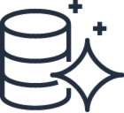



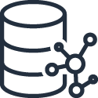
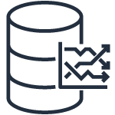


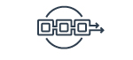
AWS purpose-built portfolio–Right Solution for the Right Outcome
Visualization & Machine Learning
QuickSight
SageMaker
Comprehend
Lex
Polly
Rekognition
Translate
Transcribe
Personalize
+ 10 more
Analytics
Redshift
EMR Spark, Hadoop
Glue Scala, Python
Athena
Elasticsearch Service
Kinesis Data Analytics
Databases
Aurora
MySQL,
PostgreSQL
RDS and RDS on VMWARE
MySQL, PostgreSQL,
Oracle, SQL Server
MariaDB
ElastiCache Redis,
Memcached
DynamoDB
Key-value
Neptune
Graph
DocumentDB
Documents
Timestream
Time Series
Data Lake Infrastructure & Management
Ledger
S3/Glacier
Lake Formation
Glue Crawl, ETL
Managed Blockchain
Quantum Ledger Database (QLDB)
Data Movement
Database Migration Service | Snowball | Snowmobile | Kinesis Data Firehose | Kinesis Data Streams | Managed Streaming for Kafka
Notes:
PRIMARY MESSAGE: AWS offers a broad and diverse set of technology to support database and analytics workloads from the application to the ingestion of the data, integration of the data all the way through analysis of the data including advanced analytics leveraging ML/AI capabilities.
DETAILED MESSAGE:
To start, if you want to address some of the issues in your flywheel by eliminating a lot of that undifferentiated heavy lifting we talked about, we offer migration services to lift and shift your on-premise relational systems to RDS. This will take away the burden of worrying about upgrades, patches, and other server maintenance not to mention creating a highly available environment that is native to the database in the cloud.
Now, operational efficiency isn’t just about having systems managed in the cloud. It is also includes abstracting away even more of the complexity that comes with server administration. Beyond just Lamda functions, AWS offers a broad array of database and analytics solutions that are serverless including Aurora Serverless for Relational technology, Athena, DyanmoDB and even for data discovery and dashboarding with Quicksight. So,instead of having to take your best guess at when your customers might peak, these serverless technologies scale to meet whatever workload you need in a matter of seconds.
Much of the complexity that we have seen creep into data and analytics platforms is because we have tried to retrofit relational technology that when conceived, was never intended to meet the demands of today’s modern workloads. As an example, to support workloads for social apps that connect friendship, followers and professional relationships, you could write thousands of lines of code and use a relational database or you could simply use Neptune, which is a graph database that was purpose-built for these kinds of workloads.
Almost every company we talk to is trying to figure out how to build a data lake that can hold all of their data and make it easy to use that information to drive the customer experience. AWS has tens of thousands of customers who use our data solutions every day.
Finally, AWS also gives you the flexibility to create your own solutions from scratch or to use out-of the box functionality. For example, you can write your own machine learning algorithms on the platform using AWS SageMaker or you can tap into advanced analytics using API’s with solutions like Personalize to support Recommendations or Lex and Polly to provide Natural Language Processing solutions and these are just a few.
Years ago, Amazon was architected as a monolithic app but quickly realized that to keep pace with the changes in demand, we had to go to a micro-sevices/purpose-built strategy. Amazon, who arguably has some of the world’s most demanding workloads, runs the business on this technology. In fact, we recently completed one of the largest migrations off of Oracle onto this platform.
So, from a technology perspective, AWS let’s you eliminate complexity, experiment with new ideas and drive to the necessary business outcome to not only get your flywheel spinning but to ensure that as things change, you can sustain momentum and continue to meet the needs of your customer.

Slide 27
Analytics
A wide range of options to use the best tool for the job
AWS Athena
AWS RedShift
JDBC/ODBC connection
AWS JDK API (Python, Java, C++, etc.)

Slide 28



Data Producers
Data Administrators (e.g., CDO)
Data Consumers
(e.g., analysts)
Discover
Analyse
Collect
Store

Slide 29
Agenda
Demonstrate AWS-native components for a data lake in the AWS Cloud (architecture) producers consumers…
Outline possible use cases, advantages, and best practices
Using examples, demonstrate lifetime and transformations of the data as it processed by the framework
Collect
Store
Discover
Analyse
Consume
Notes:
You are already familiar with the concept of Data Driven Everything and How Amazon uses AWS Services for Analytics at a Massive Scale
We will keep our presentation at the high level

Slide 30
Input Data Format
Customers
{cbgid, customer_id, education_level, first_name, last_name, marital_status, region, state}
Orders
{customer_id, order_date, price, sku}
Products
{company, link price product_category, release_date, sku}
Demographics
{bachelors_degrees, children_under_5, families_with_children, geoid, household_income, households, marriedcouple_family, middle_aged_people, owner_occupied, population, population_density, state}

Slide 31
Automate Data Quality Verification
Fully managed service; ready in a few clicks
AWS Elastic MapReduce (EMR) cluster
Deploy Spark with Deequ integration
Verify datasets for data quality requirements
Selected AWS + Deeque Capabilities
Verify value uniqueness in a column
Check data range & type (is not null, is integer, is greater or less than)
Pattern match using RegEx
Statistics (mean, percentiles, etc.)
Automatic constrain suggestion based on approved datasets

Slide 32
Deequ Input Dataset
Anonymised bank transactions (public dataset)
trans_id,account_id,date,type,operation,amount,balance,k_symbol,bank,account
1049882,3592,930110,PRIJEM,PREVOD Z UCTU,6007.00,6607.00,DUCHOD,MN,73166322
581702,1979,930309,PRIJEM,PREVOD Z UCTU,3021.00,6942.00,,UV,38265723
Must be unique
Must be in a set of allowed operations
Non negative
Null value

Slide 33
+----------+-----------------------------------------------------------------------------------------------------+
|_1 |_2 AUTOMATIC CONSTRAINT SUGGESTION |
+----------+-----------------------------------------------------------------------------------------------------+
|k_symbol |'k_symbol' has less than 46% missing values |
|k_symbol |'k_symbol' has value range 'UROK', 'SLUZBY', 'SIPO', ' ', 'DUCHOD', 'POJISTNE', 'UVER', 'SANKC. UROK'|
|k_symbol |'k_symbol' has value range 'UROK', 'SLUZBY', 'SIPO', ' ' for at least 93.0% of values |
|balance |'balance' is not null |
|balance |'balance' has type Fractional |
|amount |'amount' is not null |
|amount |'amount' has type Fractional |
|amount |'amount' has no negative values |
|bank |'bank' has less than 75% missing values |
|bank |'bank' has value range 'QR', 'AB', 'ST', 'YZ', 'GH', 'EF', 'KL', 'UV', 'OP', 'IJ', 'WX', 'MN', 'CD' |
|bank |'bank' has value range 'QR', 'AB', 'ST', 'YZ', 'GH', 'EF', 'KL', 'UV' for at least 90.0% of values |
|operation |'operation' has less than 18% missing values |
|operation |'operation' has value range 'VYBER', 'PREVOD NA UCET', 'VKLAD', 'PREVOD Z UCTU', 'VYBER KARTOU' |
|operation |'operation' has value range 'VYBER', 'PREVOD NA UCET', 'VKLAD' for at least 93.0% of values |
|account_id|'account_id' is not null |
|account_id|'account_id' has type Integral |
|account_id|'account_id' has no negative values |
|date |'date' is not null |
|date |'date' has type Integral |
|date |'date' has no negative values |
|account |'account' has less than 73% missing values |
|account |'account' has type Integral |
|account |'account' has no negative values |
|type |'type' is not null |
|type |'type' has value range 'VYDAJ', 'PRIJEM', 'VYBER' |
|type |'type' has value range 'VYDAJ', 'PRIJEM' for at least 98.0% of values |
|trans_id |'trans_id' is not null |
|trans_id |'trans_id' has type Integral |
|trans_id |'trans_id' has no negative values |
+----------+-----------------------------------------------------------------------------------------------------+
Notes:
Note that the constraint suggestion is based on heuristic rules and assumes that the data it is shown is correct, which might not be the case. We recommend to review the suggestions before applying them in production.

Slide 34
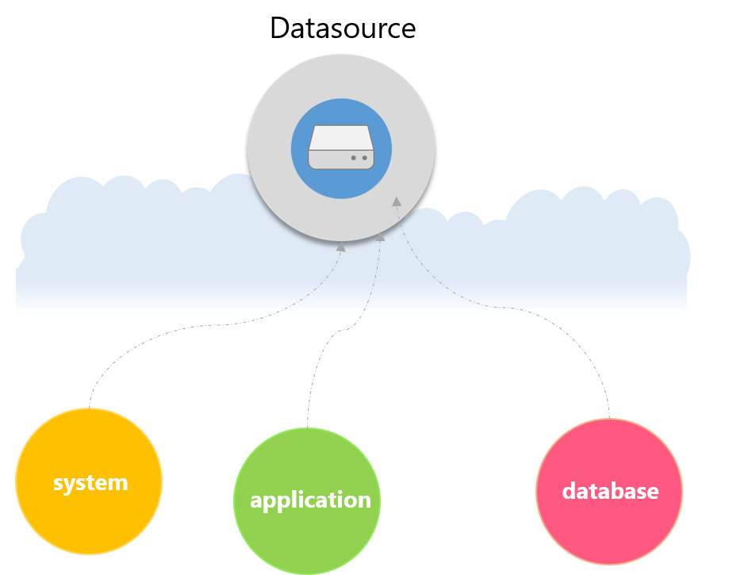
What is a Data Source?
There is no restriction on the type and there is no limit in the amount of data that can be stored in the datasource.
Notes:
There is no restriction on the type of data that can be stored in a datasource, and there is no limit in the amount of data that can be stored in the datasource. Users can select the region where the data will be stored, among the Cloud geographies that Common datahub supports.
Users can organize datasource as they wish, however a good pratice is to map a datasource to a data provider, like a system, an application or a database.

Slide 35

The Characteristics of a Data-Driven Organization
Self-service analytics at scale… increasing the agility to unlock new insights
Enable everyone to make better decisions
Unlock the hidden value of data
Enable access to all data (subject to access rules)
Notes:
PRIMARY MESSAGE: Amazon’s experience is based on migrating the world’s largest Oracle data warehouse and driving a transformation across 100+ customer businesses. At Amazon, we see self-service analytics is the fundamental enabler of an analytics transformation, enabling agility and innovation. Data-driven organizations enable everyone (people and machines) to make better decisions, faster and more innovative. Rather than remaining locked in silos, data is elevated to a strategic asset, informing creative business models, optimizing decisions and reducing risk. Democratization means that innovation is pushed to the edges, enabling the right people to experiment with their ideas, security and data privacy is a number one concern, built into all access rules.
DETAILED MESSAGE:
Enable everyone to make better decisions
People & machines
Consistent
Automated
Driving personalization
Moving from experience-based to delegated
Unlock the hidden value of data
Never throw data away
Breaking the silos and unlocking previously unseen patterns
Variety; structured and unstructured (growth of unstructured)
Velocity; fast & slow
Volume
Everyone should have access
Democratization of data
Self-service
Data privacy; responsibility
Reference:
Amazon uses AWS data lakes and analytics; Doubled data stored to 100PB; 600,000 jobs/day; lowered costs; faster insights
Enterprises that think and act in real-time, providing in-the-moment experiences to customers, business partners and employees [GE Power streaming 500,000 data records per second in order to enable real-time customer alerting; Lyft for ride location tracking system facilitating 1M rides per day, scaling to 8x more riders during peak hours].
Enterprises that automate in order to reduce waste, errors, increase governance and free-up employee time [Capital One leveraging an underlying data lake as “fuel” for models for enhanced fraud detection and customer experience; Intuit highly secure and compliant data lake supporting fraud detection with SageMaker whilst shortening time to deploy from 6 months to 1 week; Amazon drones, Samsung threat detection; Duolingo translation].
Enterprises that are highly efficient, optimized and consistent in decision making, incorporating technology-driven capabilities with workforce skills to do new kinds of work [Experian discovering new market segments, new products and improving risk score; GE Healthcare reducing instances of misdiagnosis by providing faster access for radiologists and healthcare professionals to smart medical devices backed by one petabyte of images, data and records; Finra running complex fraud, insider training and market manipulation queries over 20+ PB of data].
Enterprises that are customer-obsessed, providing highly personalized and individualized experiences and unlocking unique consumers and opportunities [Domino’s for customer experience; Epic Games driving understanding of Fortnite gamer satisfaction; Intuit].
Enterprises that are continuously learning, agile and innovative, that treat data as a strategic asset to drive the democratization of innovative ideas [Experian processes more than 1.8 billion updates per month to empower internal “data scientists and customers to discover unique insights that drive true competitive advantage”; Amazon.com running a 100PB data warehouse to drive analysis, reporting and evaluate business performance at scale].
Enterprises that are transparent and responsible in how they treat data and the insights derived [Goldman Sachs providing clients direct access to insights, risk metrics and liquidity analytics whilst maintaining utmost care of control and data privacy via “bring-your-own-key”; J&J enabling self-service analysis within J&J policy guardrails].

Slide 36
Common DataHub Solution
Where are the data?
Find the data you need with Common DataHub Virtual Data Catalog.
Data searchable by tags, description, and metadata.
Can I connect BI to that?
Data is consumable by any BI tools. No loading, no data movement, no infrastructure to buy.
Where to store the data?
The data stored in a durable and highly available storage powered by AWS.
Complex organizational structure mapped to different AWS environments.
How to make data ready-for-analytics?
Complex data transformation workflows can be implemented using simple SQL statements.
Who sees what ?
Authorized users can publish, discover, request access, and eventually use data.
Data security best practices are applied automatically by Common DataHub.
Notes:
Going back to the data story, let’s see how CommonDataHub would help the team achieve its goals faster.
Data security best practices are applied automatically by CommonDataHub, with the highest standards, for every piece of data. Data is encrypted at rest within CommonDataHub and only the entity Business Unit (BU) or Business Entity (BE) that holds the account can access (consult, delete) data stored in a given account. The same security policies are applied to all data stored on CommonDataHub.
Going Beyond
The whole purpose of CommonDataHub is to let builders build, so they can bring more intelligence in our softwares.

